Slide 1
Microsoft PowerApps

Slide 2



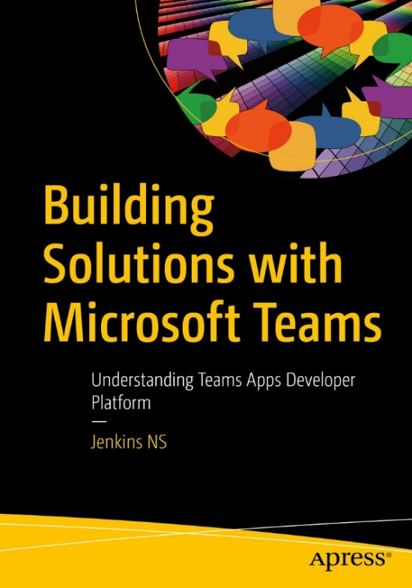








Jenkins NS
Modern Workplace Solution Architect | Consultant
18+ Years of experience
Power Platform, Microsoft Teams, and SPFx Specialist
International Speaker | Author | Trainer
SPS/M365 Bangalore Organizer
aOS Ambassador
jenkinsns@gmail.com
in/jenkinsns
@jenkinsns
http://www.jenkinsblogs.com
https://www.youtube.com/user/jenkinsns

Slide 3
Introduction to Power Platform

Slide 4

Notes:
It starts with how they get the most out of their business data
Data is everywhere – generated at every step of our lives
90% of world’s data generated in last 3 years alone
Everything we do, everything our customers do, everything competitors do generates some kind of data
T: In the old world, that data lived in siloes

Slide 5
Low Code Evolution

Slide 6

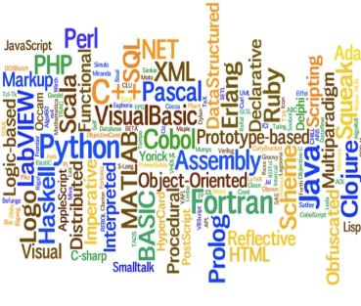


The evolution of how people buy applications
Custom Software
Packaged Software
Low-code Development
What development language do you use?
How feature rich is your software?
How agile and extensible is your platform?
ERP
CRM
HRM
ERP
CRM
HRM
Middle
-ware
MRP
Middle
-ware
PRM
MRP
PRM
MRP
OPS
LOG.
…
OPS
PRM
…

Slide 7
Benefits of low-code development platforms
Environment used to create web or mobile applications easily by mostly configurations, drop-and drops.
LOW-CODE
DEVELOPMENT PLATFORMS
Higher rate of success
Loved by both Business & IT
Breeds Innovations
Days to Weeks
Success Rate
Time to Live
Business Relevance
Innovative Culture
Traditional computer programming, writing lines of codes from scratch.
Failed projects are common
Lagging IT & constant tension with business
TRADITIONAL
DEVELOPMENT
Months to Years
Curbs Innovation

Slide 8



Microsoft Power Platform
The low-code platform that spans Office 365, Azure, Dynamics 365, and standalone applications
Innovation anywhere. Unlocks value everywhere.
Power BI
Business analytics
Power Apps
Application development
Power Automate
Process automation
Power Virtual Agents
Intelligent virtual agents
Data connectors
Portals
AI Builder
Common Data Service(Data verse)

Slide 9




Who here has a Microsoft 365 background?
SharePoint, Teams, Exchange…
Microsoft 365
Analyze
Act
Automate
Data connectors
Power BI
Business analytics
Power Apps
Low-code/no-code application development
Power Automate
Workflow automation
Standalone apps
Common Data
Service
AI Builder

Slide 10

What about a Dynamics 365 background?
Sales, Service, Talent…
Microsoft 365
Dynamics 365
Analyze
Act
Automate
Data connectors
Power BI
Business analytics
Power Apps
Low-code/no-code application development
Power Automate
Workflow automation
Standalone apps
Common Data
Service
AI Builder

Slide 11
Last, but not least, what about Azure?
Azure SQL, Azure Functions…
Microsoft 365
Dynamics 365
Microsoft Azure
Analyze
Act
Automate
Data connectors
Power BI
Business analytics
Power Apps
Low-code/no-code application development
Power Automate
Workflow automation
Standalone apps
Common Data
Service
AI Builder

Slide 12
Why Power Platform?
Time
Resources
Price
Data
Maintenance

Slide 13
Introduction
InfoPath
PowerApps
License Options and Costs
Setup Environment

Slide 14
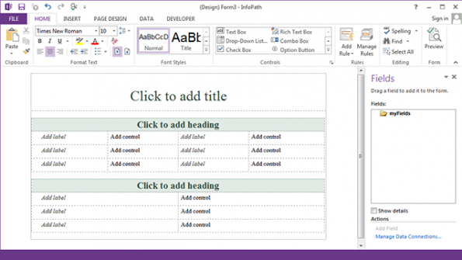
InfoPath
WYSIWYG Form designer
Form Filler
Form Publishing
Outlook/SharePoint Task Integration
Custom Actions (Custom Code)

Slide 15
InfoPath replacement?
InfoPath replacement. It is a successor, not a replacement.
Limited functionalities
List forms
Microsoft stated there will be no 1:1 parity
SharePoint-specific product
Limited SharePoint support
Will get better

Slide 16
What is PowerApps?
Microsoft PowerApps is a new platform to create line of business mobile applications that can be built in minutes without the need of writing code (also known as No code/Low-Code platform) or worrying about all the complexity involved in writing cross platform applications that support iOS, Android, Windows Phone, Windows and the web. PowerApps allows you to easily build applications that connect to several data sources, including SQL databases, SharePoint lists, Excel Spreadsheets, Office 365, Dynamics CRM, OneDrive, Dropbox, Google Drive, Trello, Facebook, Twitter, Wunderlist, and more. But more importantly it includes a new secure business database called the Microsoft Common Data Model.
PowerApps provides a very powerful and yet simple experience that allows you to build applications with rich mobile capabilities such as access to Camera, GPS, etc. while providing a modeling experience as simple as Microsoft PowerPoint and providing a familiar way to express logic like Microsoft Excel.

Slide 17
Line of business mobile applications
As mobile technology continues to evolve and improve, mobile devices have taken over every interaction in the consumer/personal space where mobile applications exist to help us in every aspect of our lives - from social networks, photo sharing, interactive media, news, smart home tools and many more - almost everything we need can be found in your favorite mobile device application store. However, on the enterprise/professional space this has not yet been the case and the modern workforce struggles daily to gain access to most of their internal LOB applications running on legacy systems that are hard to expose to mobile devices, from expense reports, invoice management, absence reporting, sales tools, time tracking and many more are examples of key data that historically has only been accessible in the internal network through intranet applications. Numerous research studies have shown that there is a huge interest by companies to empower their employees and mobilize these applications and their data for them, however, the cost and complexity of building mobile applications (not to mention supporting multiple devices and platforms) has been getting on the way of internal IT teams on scaling and keeping up with the large number of applications

Slide 18
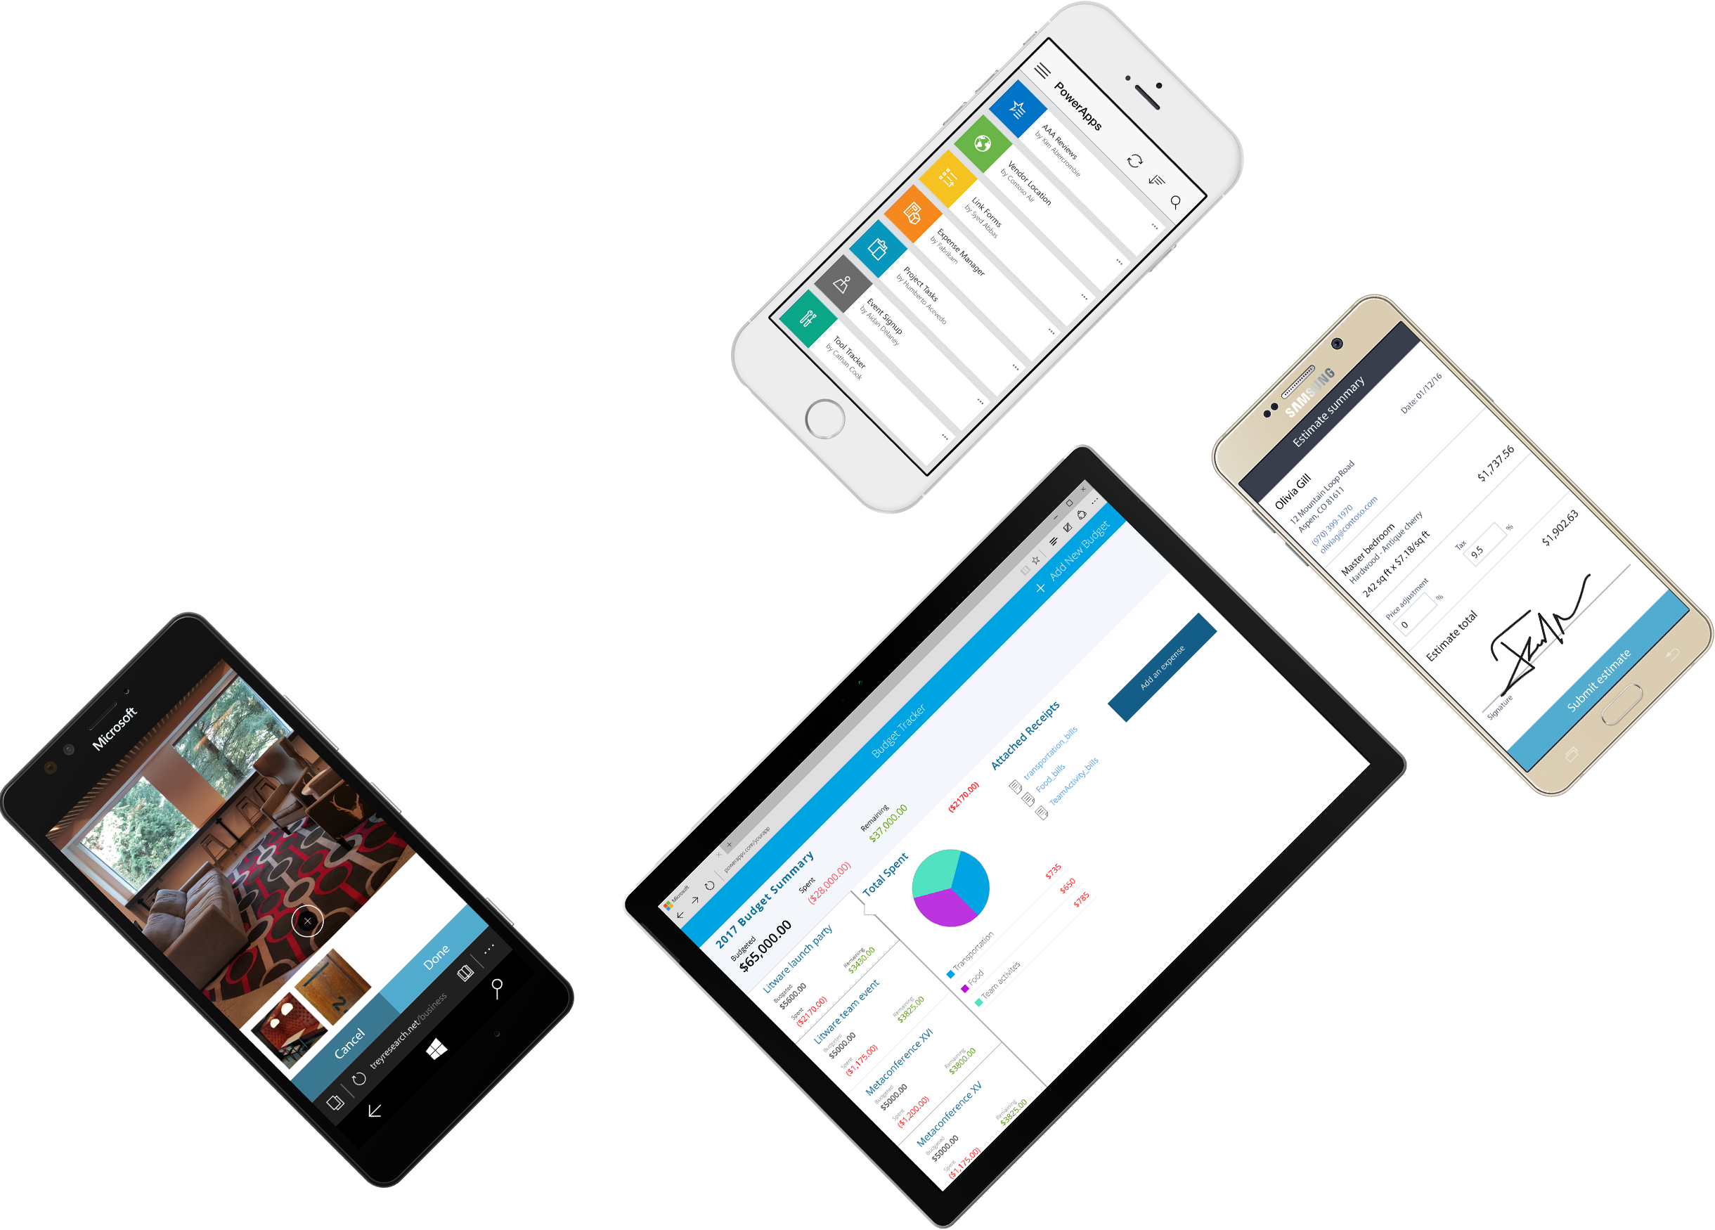
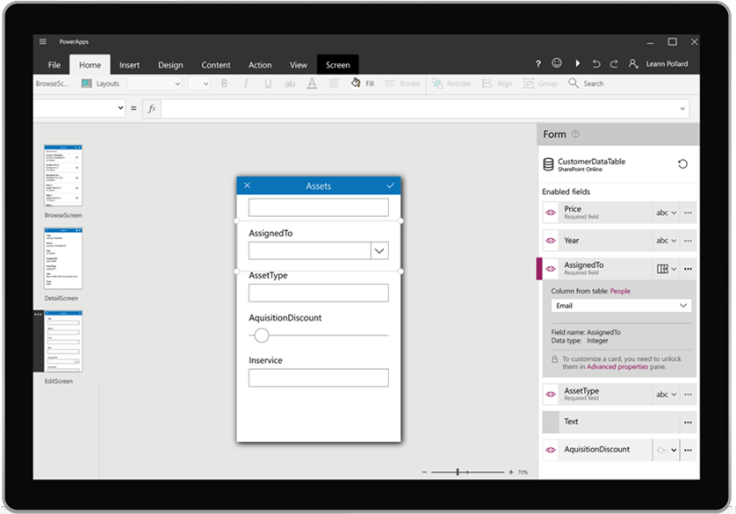






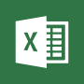







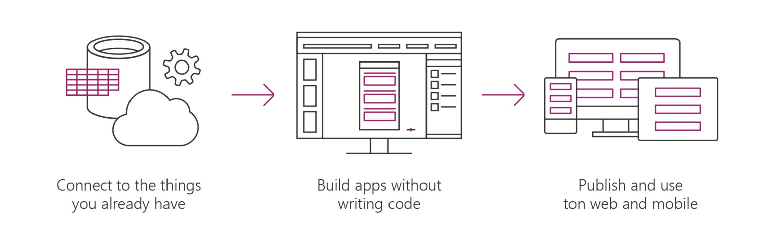




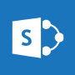






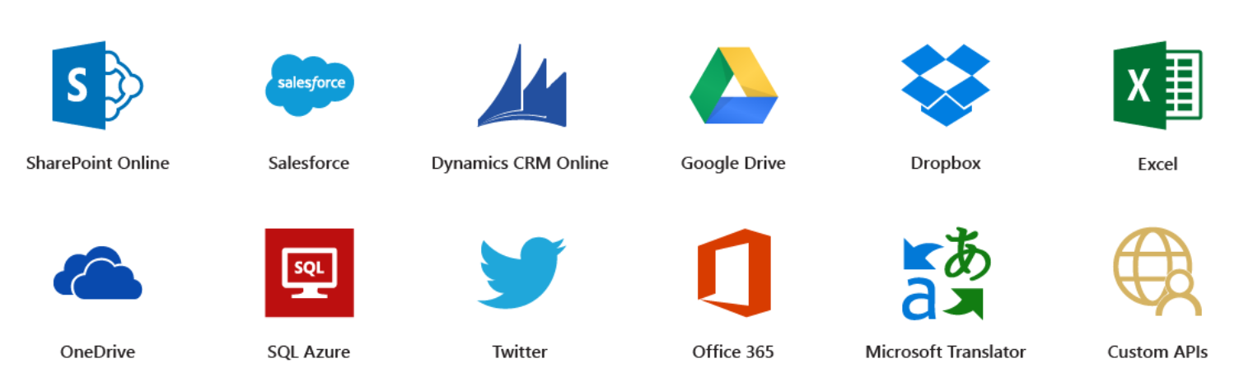




Microsoft PowerApps
Connect to existing systems and data sources
Common Data Platform
Azure Functions & REST services
Build apps, forms, and workflows without writing code
Publish apps instantly for web and mobile
Notes:
Microsoft PowerApps is a service for creating and using custom business apps across platforms

Slide 19
Benefits of PowerApps
Secure Scalable Managed Integrated Compliant
Fast Iterative
Cross-platform
Beautiful Easy

Slide 20
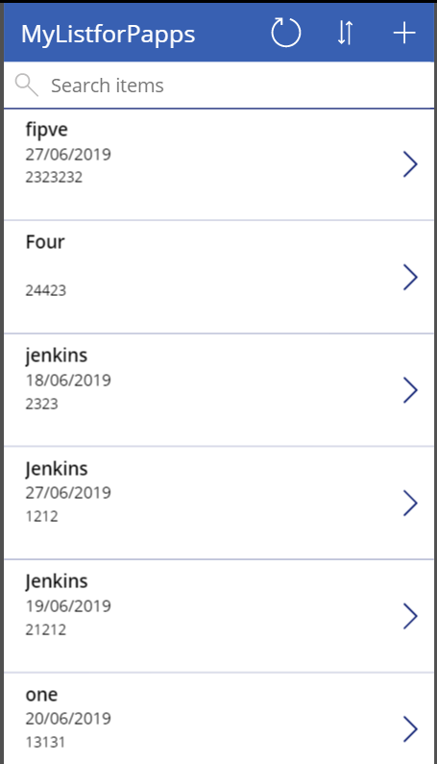
What can I build with PowerApps?
Apps based on data (SharePoint*, SQL, but also DropBox and Google Drive)
Onedimensional, form-based apps
Simple, single-task apps Microphone, camera, GPS coordinates. Ink and pen support.
Multiple data sources in one app Multiple screens

Slide 21
PowerApps for Office 365
https://docs.microsoft.com/en-us/power-platform/admin/pricing-billing-skus
https://powerapps.microsoft.com/en-us/blog/new-licensing-options-for-powerapps-and-flow/

Slide 22
License Options and Costs
Extending Office 365 and Dynamics 365
For business users
Run any app using CDM
For creators and IT admins
Full creation & admin capabilities
PowerApps Per App Plan
PowerApps and MSFT Flow for
Office 365 and Dynamics 365
PowerApps P1
PowerApps P2
New licensing options for PowerApps
Included with O365 & D365 workloads PowerApps & MSFT Flow capabilities Create & run within the context of O365 & D365 data sources |  | PowerApps & MSFT Flow capabilities Access to Common Data Model and premium connectors Run any app or flow & build against any existing data source |  | Included in full D365 Plans Includes everything in P1, plus Create any app or flow Model your business data and create custom entities (CDM) Create/manage environments and databases Set policy and view usage
Quotas (per user; pooled tenant-wide): 2,000 flow runs per month |  | Quotas (per user; pooled tenant-wide): 4,500 flow runs per month 20MB Data Storage 2GB File Storage |  | Quotas (per user; pooled tenant-wide): 15,000 flow runs per month 200 MB Data Storage 20 GB File Storage per user
Allow individual users to run applications for a specific business scenario based on the full capabilities of PowerApps. Pricing will be $10 user/app/month.
Additional flow runs, Data Storage, and File Storage may be purchased as needed
Notes:
https://docs.microsoft.com/en-us/power-platform/admin/pricing-billing-skus
https://powerapps.microsoft.com/en-us/blog/new-licensing-options-for-powerapps-and-flow/
https://powerapps.microsoft.com/en-us/pricing/

Slide 23
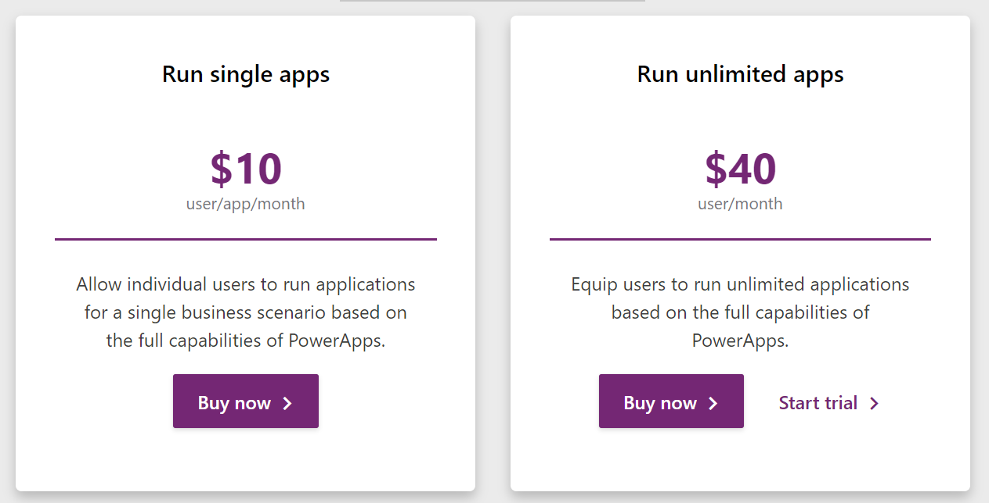
Notes:
https://powerapps.microsoft.com/en-us/pricing/

Slide 24
License Options and Costs for external Users
PowerApps Portals
PowerApps Portals provide low-code tools to build responsive websites that connect an organization with external customers or partners. This is done by providing the ability to create a new portal app which can be accessed by internal users, anonymous external users, or by authenticating external users with LinkedIn, local logins, Microsoft accounts and many other identity providers. The ability to access PowerApps Portals is included as part of the new PowerApps per user and per app plans for internal users.
PowerApps Portals will be licensed per the following:
External users (authenticated) will be $200 for 100 logins/month
External users (anonymous) will be $100 for 100,000 web page views/month.
Internal users are able to access portals using a PowerApps per app or per user plan as per previous slide.
Additional flow runs, Data Storage, and File Storage may be purchased as needed
Notes:
https://docs.microsoft.com/en-us/power-platform/admin/pricing-billing-skus
https://powerapps.microsoft.com/en-us/blog/new-licensing-options-for-powerapps-and-flow/
https://powerapps.microsoft.com/en-us/pricing/

Slide 25
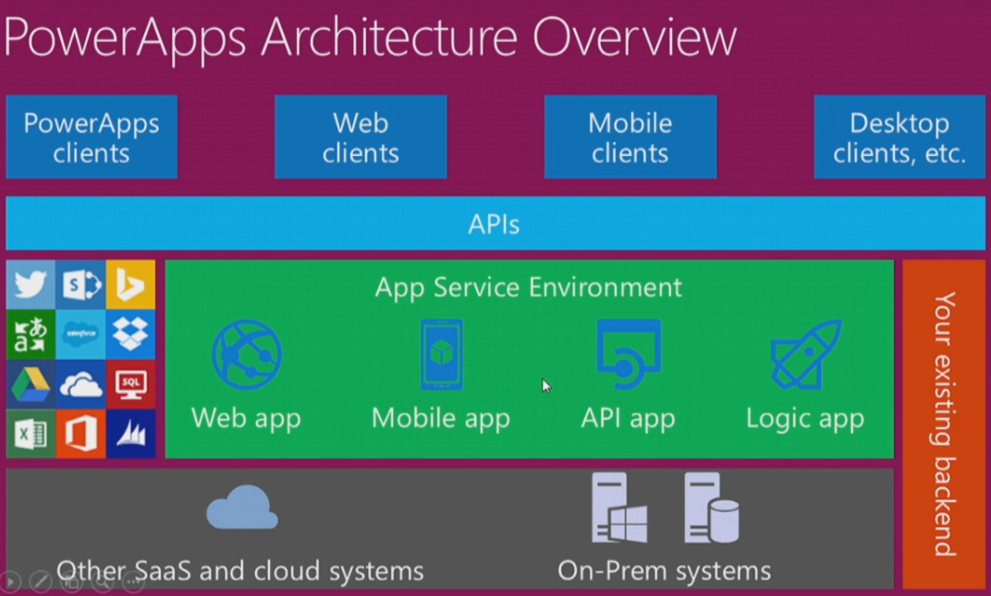

Slide 26
Setup Environment
Setup Office 365
Go to https://docs.microsoft.com/en-us/office/developer-program/office-365-developer-program-get-started
Signup for a free 3 months office 365 E5 developer subscription
Setup PowerApps
Go to https://powerapps.microsoft.com/en-us/
Or
https://powerapps.microsoft.com/en-us/communityplan/

Slide 27
Creating PowerApps from a Data Source Create a First PowerApps using Excel Sheet

Slide 28




Let’s talk about data
Analyze
Power BI
Know
Act
Automate
Power Apps
Automate
AI Builder
Learn

Slide 29




Let’s talk about data
Analyze
Power BI
Know
Act
Automate
Power Apps
Automate
Connectors
AI Builder
Learn

Slide 30

Let’s talk about data
Analyze
Power BI
Know
Act
Automate
Power Apps
Automate
CDS
AI Builder
Learn

Slide 31

Two Types of Data. . .
External
Internal

Slide 32
Two Types of Data. . .
Connectors
Common Data Service

Slide 33
Oh, the apps you can build. . .
Client | Connectors | Common Data Service (Data Verse)
Power Apps (Canvas) | Yes | Yes
Power Apps (Model) | No | Yes
Power Portals | No | Yes
Power Automate | Yes | Yes
AI Builder | No | Yes
PowerBI | Yes | Yes

Slide 34
Why external data (Connectors)?
It’s easy
It’s home

Slide 35

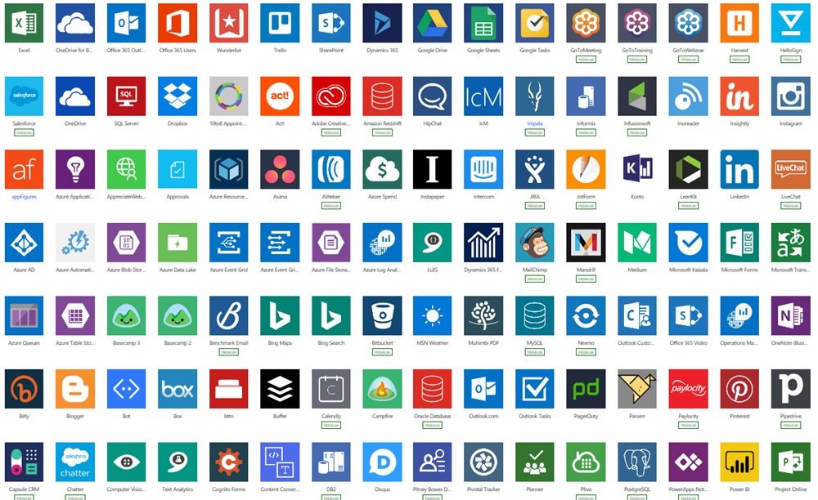
Why external data (Connectors)?
Built-in connectivity to 486+ cloud services, content services, databases, APIs, etc.
Seamless hybrid connectivity to on-premises systems via the on-premises data gateway.
Develop and register custom connectors as a building block for citizen developers.
Connect data silos by using multiple data sources in a single application.

Slide 36
Why internal data (Common Data Service) Data verse?
It’s smart
It scales
It’s secure

Slide 37
What is the Common Data Service (Data verse)?
The Common Data Service easily structures
a variety of data and business logic to support
interconnected applications and processes
in a secure and compliant manner

Slide 38
Canvas App vs Model-Driven Apps

Slide 39

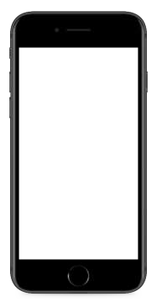


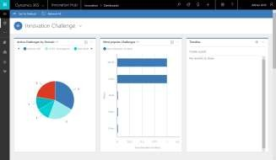
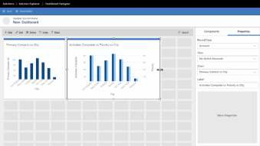


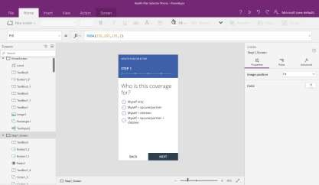
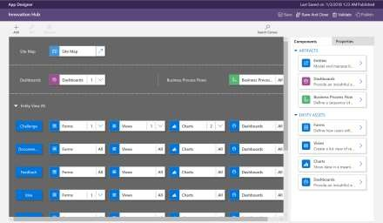


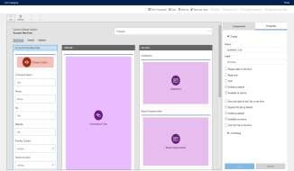
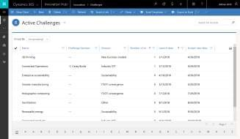
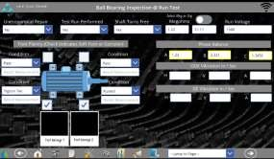
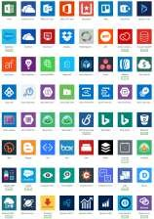
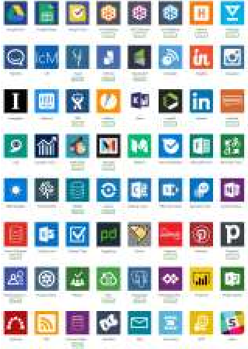

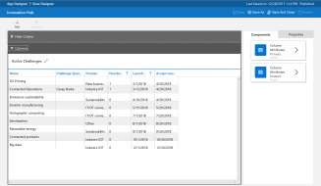
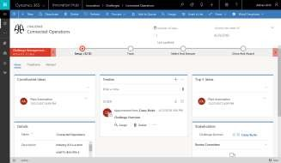
Canvas apps
Start with user experience WYSIWYG designer
Role-based apps
Mash up data from 484+ sources
Model-driven apps
Built on the Common Data Service for Apps Start with a data model, relationships, and business processes
Build End-to-End business applications

Slide 40
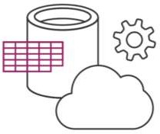
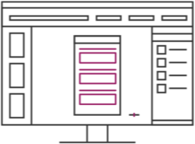
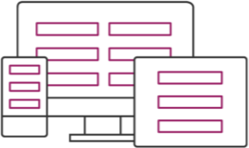
Canvas Apps help business-power-users to create and use custom business apps across platforms
using Excel and PowerPoint skills
Connect to data & systems you’re already using easily
Create apps, forms, and workflows without writing code
Use apps on any device – both web and mobile

Slide 41
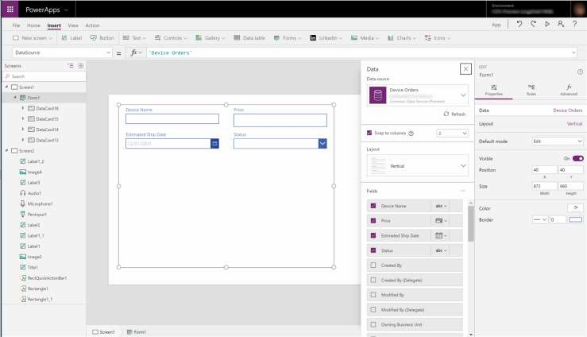
EASY AUTHORING
Truly WYSIWYG – full control over user experience, use it as you build it
Create app logic with familiar Excel-like expressions
Mash up data from multiple
sources right at the app level

Slide 42
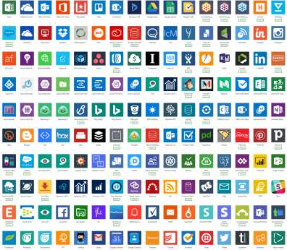
CLOUD AND ON-PREMISES CONNECTIVITY
Built-in connectivity to 484+ cloud services, files, databases, web APIs, etc.
Seamless hybrid connectivity to on- premises systems via the On- Premises Data Gateway
Build custom connectors for everyone to leverage

Slide 43
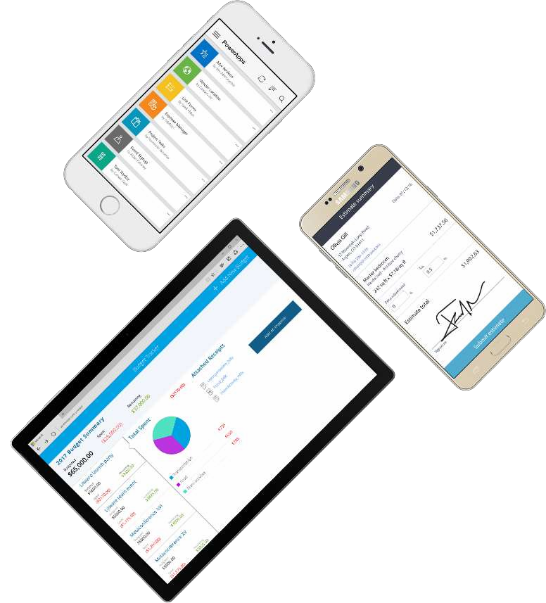
CROSS-PLATFORM
Publish instantly to iOS, Android,
Windows, and the web
Sharing apps is like sharing documents
Manage across environments

Slide 44
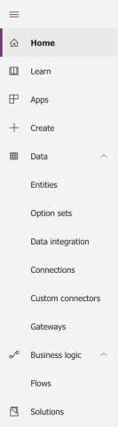
POWERAPPS MAKER PORTAL [HTTPS://WEB.POWERAPPS.COM/]
Home page for Makers
Learn
Guided learning, documentation, community, what’s new
Apps
View apps, open apps, create new apps, run sample apps, create apps from sample apps
Create
Create new apps from blank or from sample apps
Data
Manage Entities, option sets, data integration, connections, custom connections & gateways
Business Logic
Add Flows to your apps
Solutions
Create packages of PowerApps, Flows and CDS Entities (Solutions), distribute them to your customers or move them across environments

Slide 45
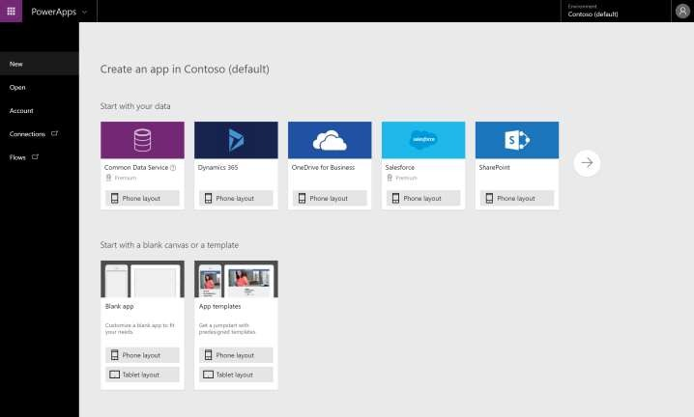
POWERAPPS STUDIO FOR THE WEB [HTTPS://CREATE.POWERAPPS.COM/]
Canvas apps authoring experience
Start with your data
Start with a blank canvas
Start with a template

Slide 46
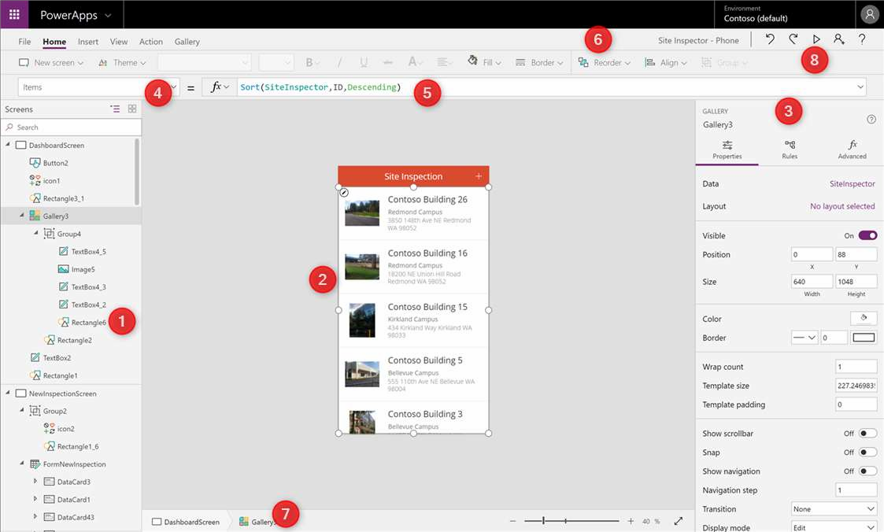
POWERAPPS STUDIO PARTS
Left Navigation bar
Middle pane (current screen)
Right hand pane
Property Pane
Formula bar
Ribbon
Bread crumb navigation
Preview button (F5)

Slide 47

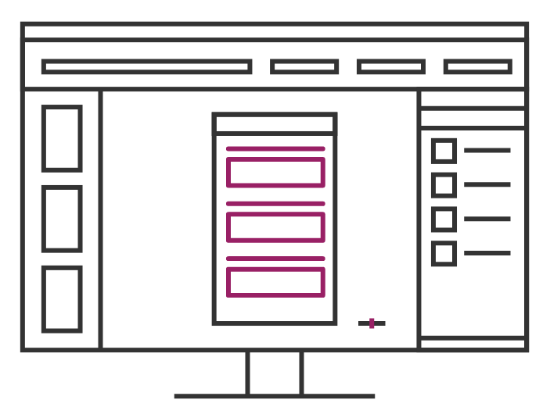
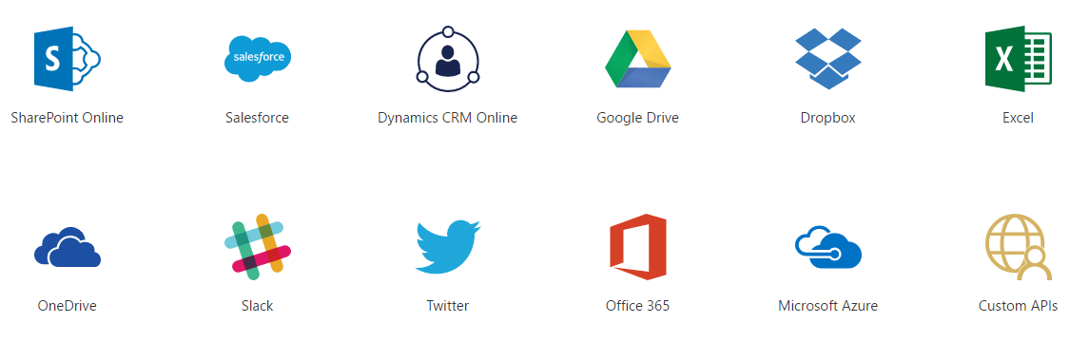
Data Sources and connections

Slide 48
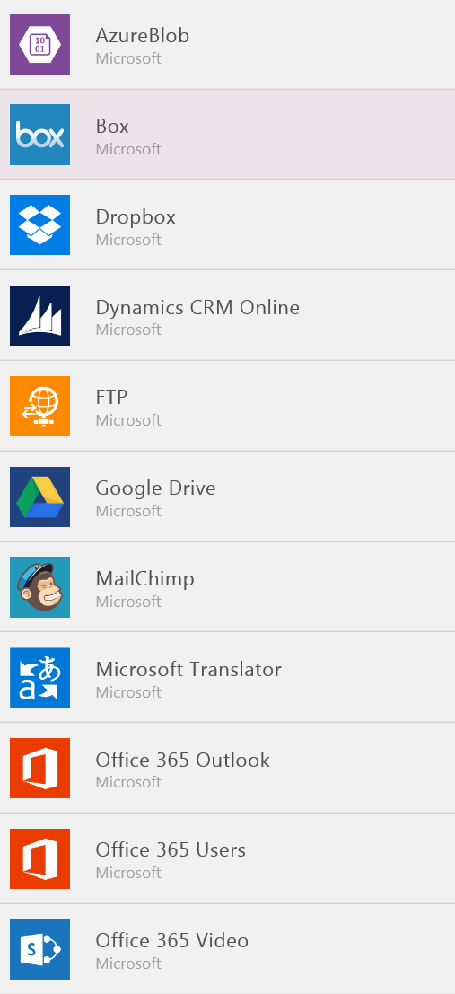
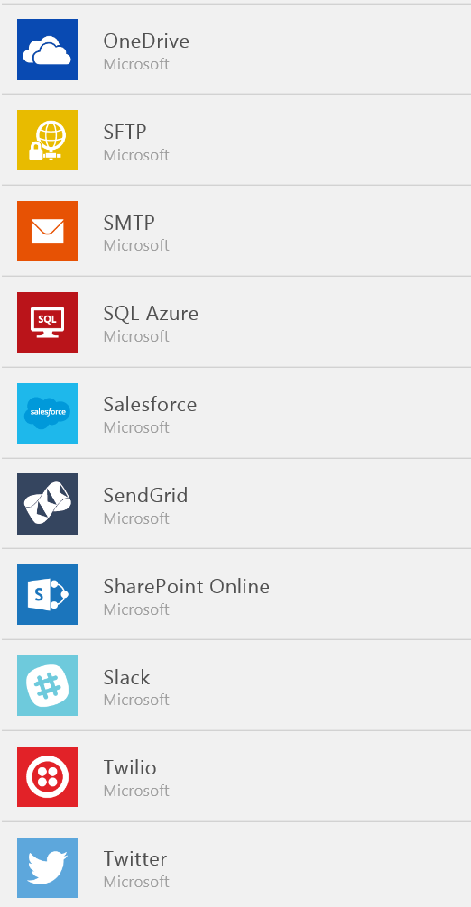
Data Sources…
SaaS Data Sources
Excel on OneDrive
Excel on Dropbox
Excel on Google Drive
Office 365
SharePoint Online Lists
Google Sheets
Sales force
Dynamics CRM

Slide 49
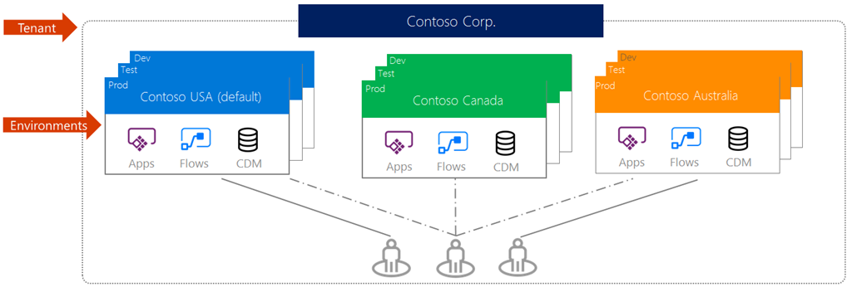
Environments
Support for environments to enable enterprise scale out and improved manageability

Slide 50
Demo & Hands-on

Slide 51
Creating PowerApps
Creating PowerApps from a Data Source
Creating PowerApps from a Blank

Slide 52
Creating PowerApps from a Data Source Create a PowerApps using SharePoint

Slide 53

Creating PowerApps from Blank
Customizing Screens
Working with Layouts and Fields
Working with Controls and Data Card
Working with the Formula Bar
Form interactivity and navigation
Working with Cascading control
Notes:
https://docs.microsoft.com/en-us/powerapps/maker/canvas-apps/formula-reference
Edit Screen - Item
- Gallery3.Selected
Default Mode
FormMode.View, New, Edit
onSelect
ViewForm(Form1)
EditFolrm(Form1)
NewForm(Form1)
ResetForm(Form1)
SubmitForm(Form1)
Visible
If(Form1.Mode = FormMode.Edit,true,false)
cancel
!(Form1.Mode = FormMode.View)
cascading
- Country - Sort(Distinct(Country,Title),Result)
- State - Filter(Country,Title=Dropdown1.Selected.Result)

Slide 54
Branding and Media
Linking control properties
Backgrounds
Colors and transparency
Duplicating screens
Copying the look and feel
Using images
Embed and play audio and video

Slide 55
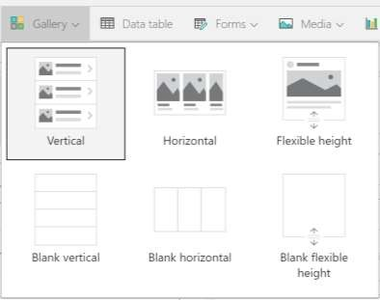
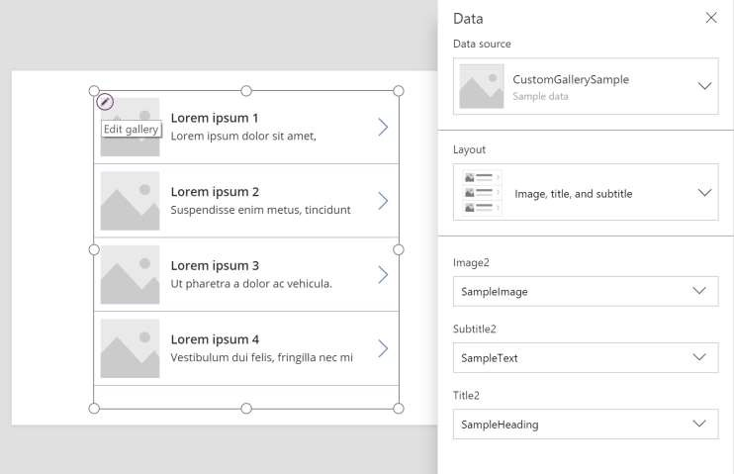
GALLERY

Slide 56
Demo & Hands-on

Slide 57
PowerApps Controls
Labels
Buttons
Text inputs
Controls
Galleries
Data tables
Forms
Media
Charts
Icons

Slide 58
Demo & Hands-on

Slide 59
Formulas, Variables & Collections
Understand & implement variables
Using important functions
Understand & implement collections
Notes:
https://docs.microsoft.com/en-us/powerapps/maker/canvas-apps/working-with-variables
https://docs.microsoft.com/en-us/powerapps/maker/canvas-apps/formula-reference
https://docs.microsoft.com/en-us/powerapps/maker/canvas-apps/create-update-collection

Slide 60
Variables
PowerApps has three types of variables:
Variables type | Scope | Description | Functions that establish
Global variables | App | Simplest to use. Holds a number, text string, Boolean, record, table, etc. that can be references from anywhere in the app. | Set
Context variables | Screen | Great for passing values to a screen, much like parameters to a procedure in other languages. Can be referenced from only one screen. | UpdateContext Navigate
Collections | App | Holds a table that can be referenced from anywhere in the app. Allows the contents of the table to be modified rather than being set as a whole. Can be saved to the local device for later use. | Collect ClearCollect

Slide 61
Variables…
Global Variable
Set( VariableName, Value )
Ex: Set( Name, ”Jenkins” )
Set(Calval1,Label3.Text)
Context Variable
UpdateContext({VariableName:Value})
Ex: UpdateContext( { Name: "Lily", Score: 10 } )
UpdateContext({CalVal:Label3.Text})
Set Context Variable to other screen
Navigate(Screen2,{CalValnew: CalVal})

Slide 62
Collection
A collection is used to store data that can be used in your app or we can say a collection is a group of items that are similar.
Collect – Add new item to the collection
Collect(colItems, {Product:val1, Qualtity:val2})
Clear – Clear all records from the collection
Clear(colItems)
Remove – remove selected item from the collection
Remove(colItems,ThisItem)
ClearCollect – Clear all records and add new item to the collection
ClearCollect((colItems, {Product:val1, Qualtity:val2}, {Product:val3, Qualtity:val4})
Patch – Update new Item to the collection
Patch(colItems,Gallery1.Selected, {Product:val1, Qualtity:val2})

Slide 63
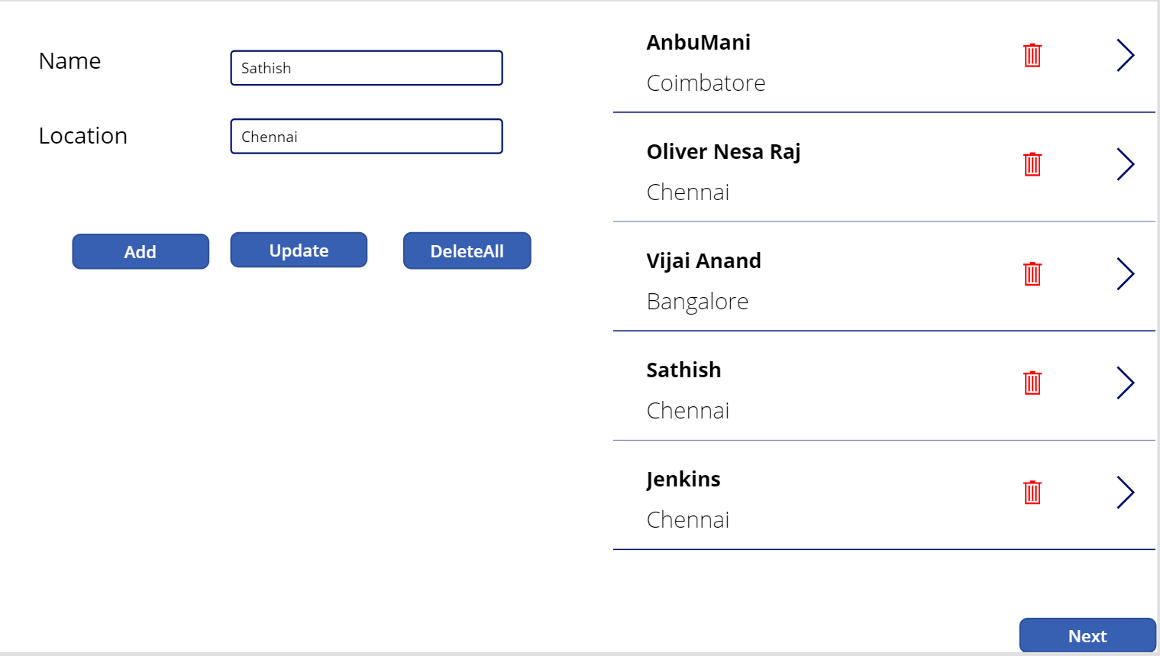
Collection Example 1

Slide 64
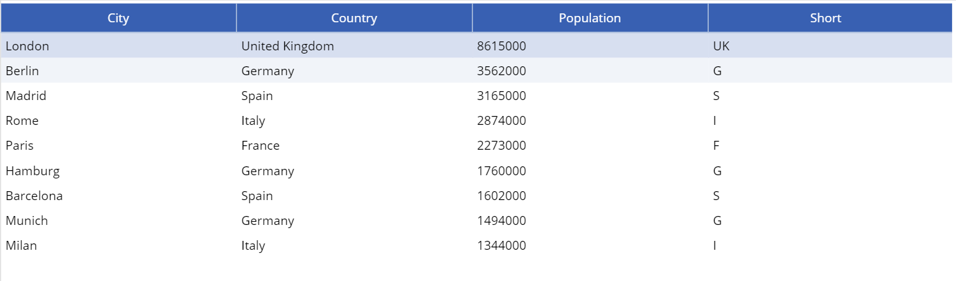
Collection Example 2

Slide 65
Patch, Defaults, Update If
Use the Patch function to modify records in complex situations, such as when you perform updates that require no user interaction or use forms that span multiple screens.
In less complex situations, you can use the Edit form control to update records in a data source more easily. When you add an Edit form control, you provide users with a form to fill in and then save the changes to a data source
Use Patch with the Defaults function to create records. Use this behavior to build a single screen for both creating and editing records.
Patch(ListName,Defaults(ListName),{
Title:txtticketname.Text,
Priority: CreateTicketScreenPriorityDropDown.SelectedText.Value,
TaskStatus:DropDown.SelectedText.Value,
Description:TaskDescription.Txext
});
Notes:
https://docs.microsoft.com/en-us/powerapps/maker/canvas-apps/functions/function-patch
Patch(ListName,Defaults(ListName),{
Title:txtticketname.Text,
Priority: CreateTicketScreenPriorityDropDown.SelectedText.Value,
TaskStatus:DropDown.SelectedText.Value,
Description:TaskDescription.Txext,
Category:{'@odata.type':"#Microsoft.Azure.Connectors.SharePoint.SPListExpandedReference", Id: CategoryDropDown.SelectedText.ID, Value: CategoryDropDown.SelectedText.Value}
});

Slide 66
Disambiguation operator
Field names added with the record scope override the same names from elsewhere in the app. When this happens, you can still access values from outside the record scope with the @ disambiguation operator
To access global values, such as data sources, collections, and context variables, use the pattern [@ObjectName] (without a table designation).

Slide 67
Connectors

Slide 68
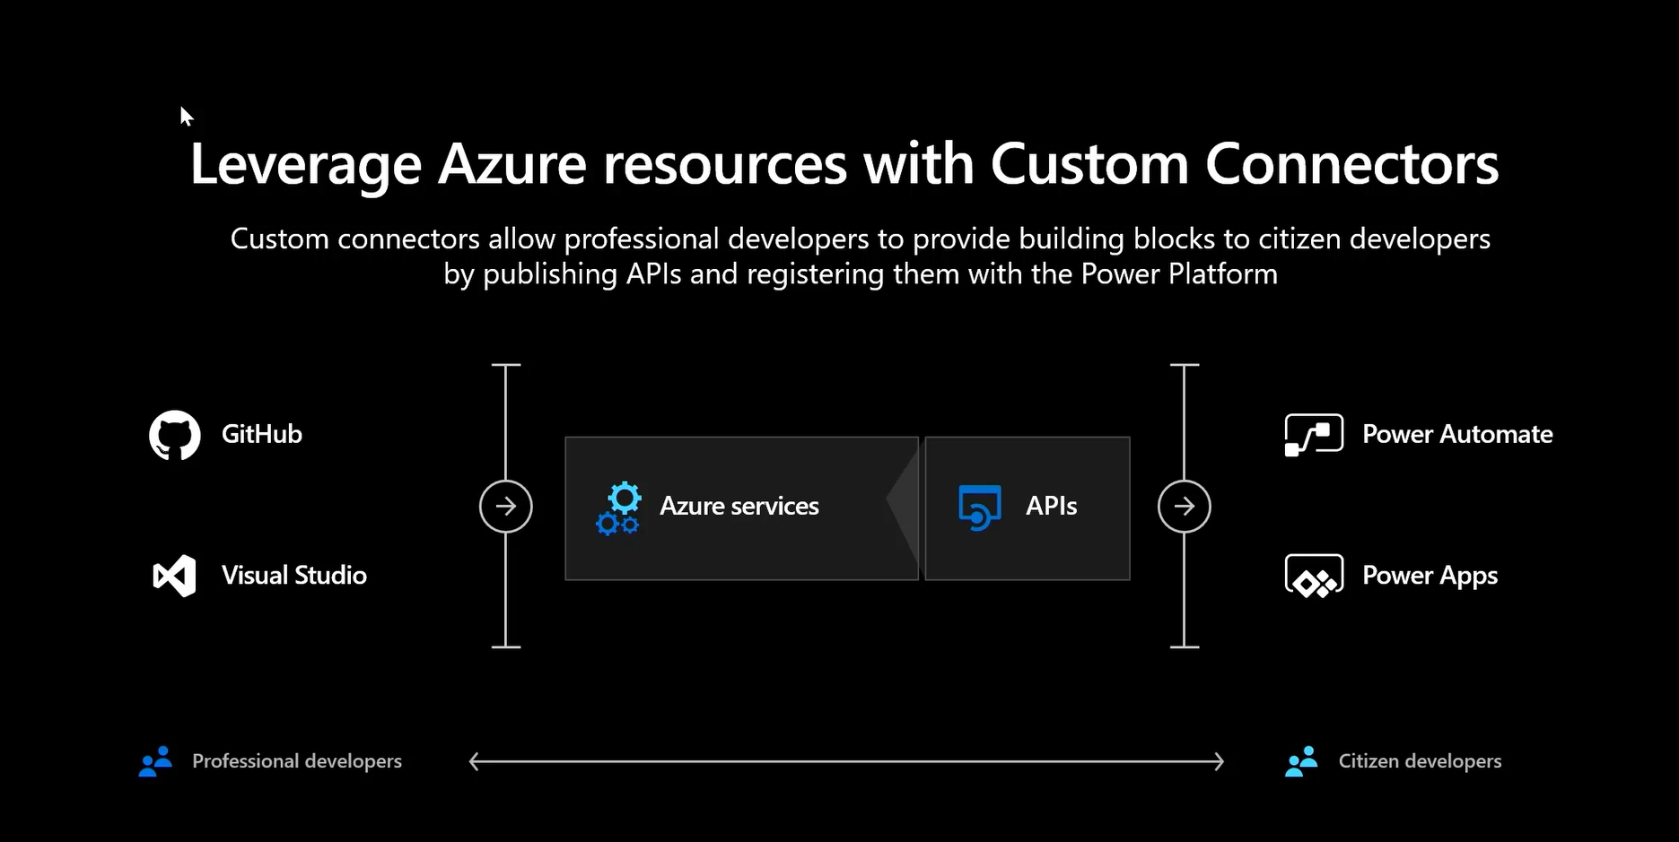

Slide 69
Why build a connector?
Enterprise developers
Looking for connectivity to a service we don’t currently support
Need connectivity to a custom or internal service
Partners and ISVs
Expand the number of services you integrate with
Provide the extensibility your customers need
Increase exposure and adoption

Slide 70
Building a Custom Connector



Develop
Build, secure and describe your API
Import from existing artifacts (Open API, Postman) or build from scratch
Test
Validate your API calls
Use in Flow and PowerApps for E2E testing
Share
Allow other users within your organization to use your connector

Slide 71
Building a Custom Connector




Develop
Build, secure and describe your API
Import from existing artifacts (Open API, Postman) or build from scratch
Test
Validate your API calls
Use in Flow and PowerApps for E2E testing
Share
Allow other users within your organization to use your connector
Certify
Share your connector with all users of Flow and PowerApps
Only for Public Connectors

Slide 72
Custom connector architecture
Hosting environment
Connector ID
+
Operation
+
Connection ID
Host
+
Path
+
Credentials
RESTful API
Microsoft Flow
Custom connector
PowerApps

Slide 73
Using your own Web API
Hosting environment
Your
Web API
Microsoft Flow
Custom Connector
PowerApps

Slide 74
Securing your Web API
Hosting environment
AAD Application #1
AAD Application #2
Your
Web API
Microsoft Flow
Custom Connector
PowerApps

Slide 75
Connectors Demo

Slide 76







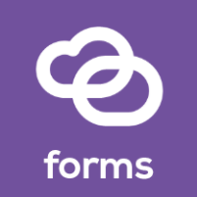




Custom Connector Resources
https://docs.microsoft.com/connectors
Custom connectors
From Postman Collection
Webhooks
Dynamic values/schema
https://aka.ms/apiconnectors
Submit for certification
Example Video : https://youtu.be/dBCS1nPsDiE
Notes:
https://www.googleapis.com/books/v1/volumes?q=search
https://www.googleapis.com/books/v1/volumes?q=ISBN:9780789748591
Gallery
First(mybooks).items
ThisItem.volumeInfo.imageLinks.thumbnail
ThisItem.volumeInfo.title
ThisItem.volumeInfo.description
Host : www.googleapis.com
Base Url: /books/

Slide 77
Demo & Hands-on
Connect REST API using connector
Notes:
https://docs.microsoft.com/en-us/powerapps/maker/model-driven-apps/embedded-canvas-app-add-classic-designer
https://www.sharepointpals.com/post/step-by-step-procedure-to-call-sharepoint-office-365-rest-api-from-microsoft-flow/

Slide 78
Model-driven apps
Canvas apps
Start with user experience WYSIWYG designer
Role-based apps
Mash up data from 484+ sources
Built on the Common Data Service for Apps Start with a data model, relationships, and business processes
Build End-to-End business applications

Slide 79
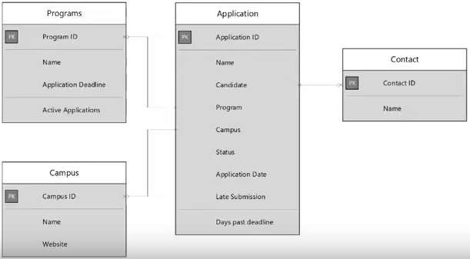
Data model design
Option Sets
Entities
Fields Data type
Relationships
Field mapping

Slide 80
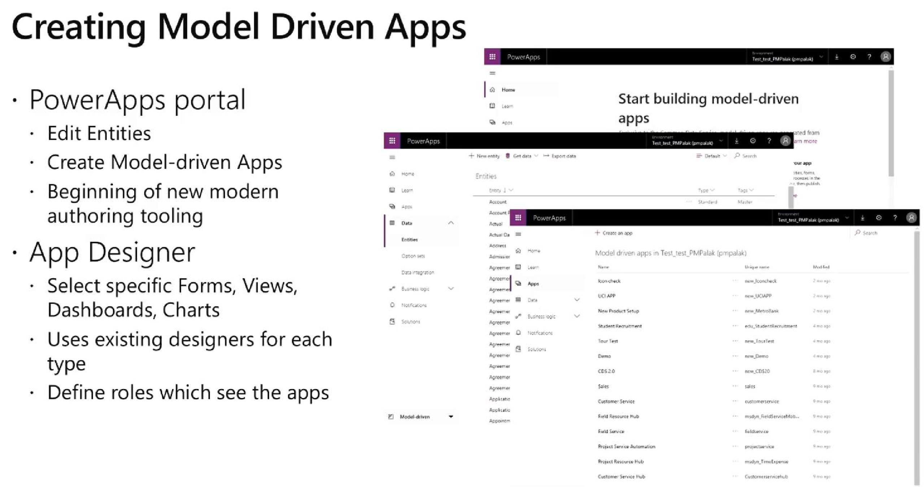

Slide 81
Demo & Hands-on

Slide 82
Use case
Develop a Helpdesk application
Notes:
https://powerapps.microsoft.com/en-us/blog/category/case-studies/

Slide 83
For Developers: Extending PowerApps and Flow
Adding custom data sources to PowerApps
Extending PowerApps language through Azure API Apps
Extending PowerApps with Azure Functions
Exchanging data from PowerApps with 3rd party system using Azure Service Bus
Using Azure API Apps to create custom Flow Action

Slide 84
Warning
PowerApps are published as a Minimum Viable Product: things are changing. Prepare for change, and make your plans flexible.
First prove that feature you require is supported by PowerApps, or is at least on the roadmap, to avoid dead-ends.
Don’t overpromise.
You might end up deploying hacks as workarounds

Slide 85
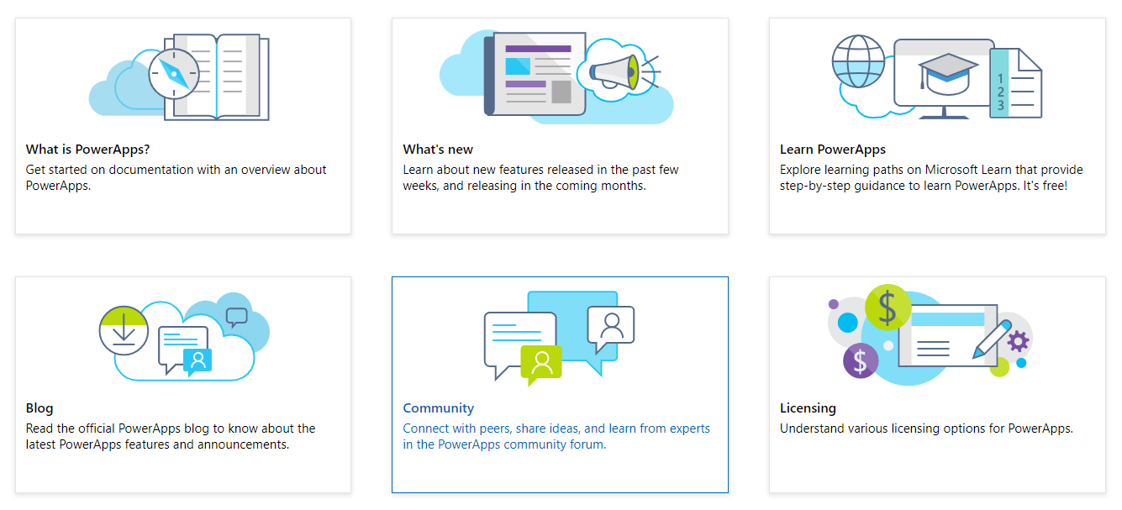
PowerApps Documentation
Notes:
https://docs.microsoft.com/en-us/powerapps/#pivot=home&panel=getstarted

Slide 86
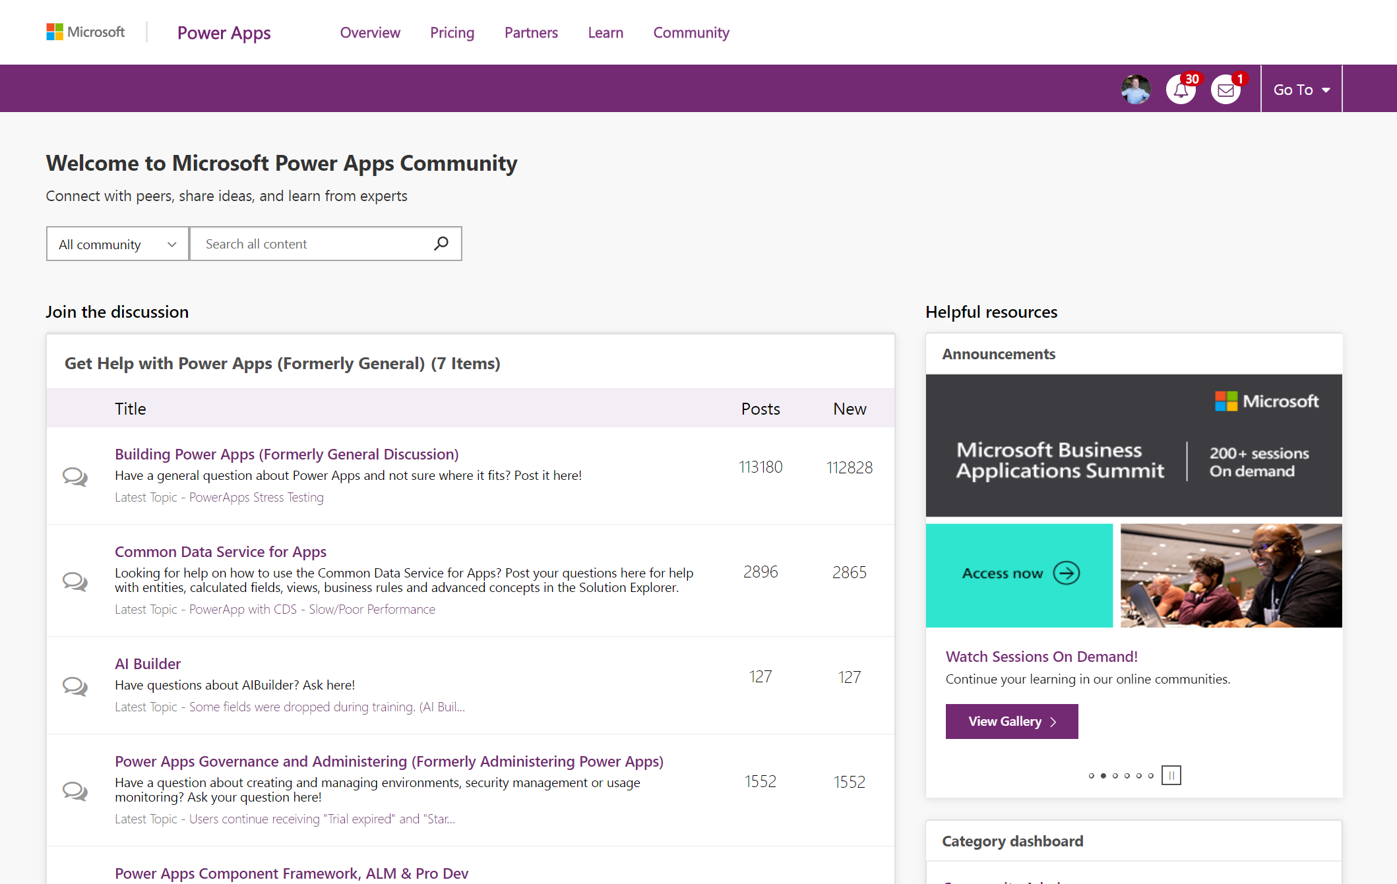
aka.ms/PowerAppsCommunity

Slide 87
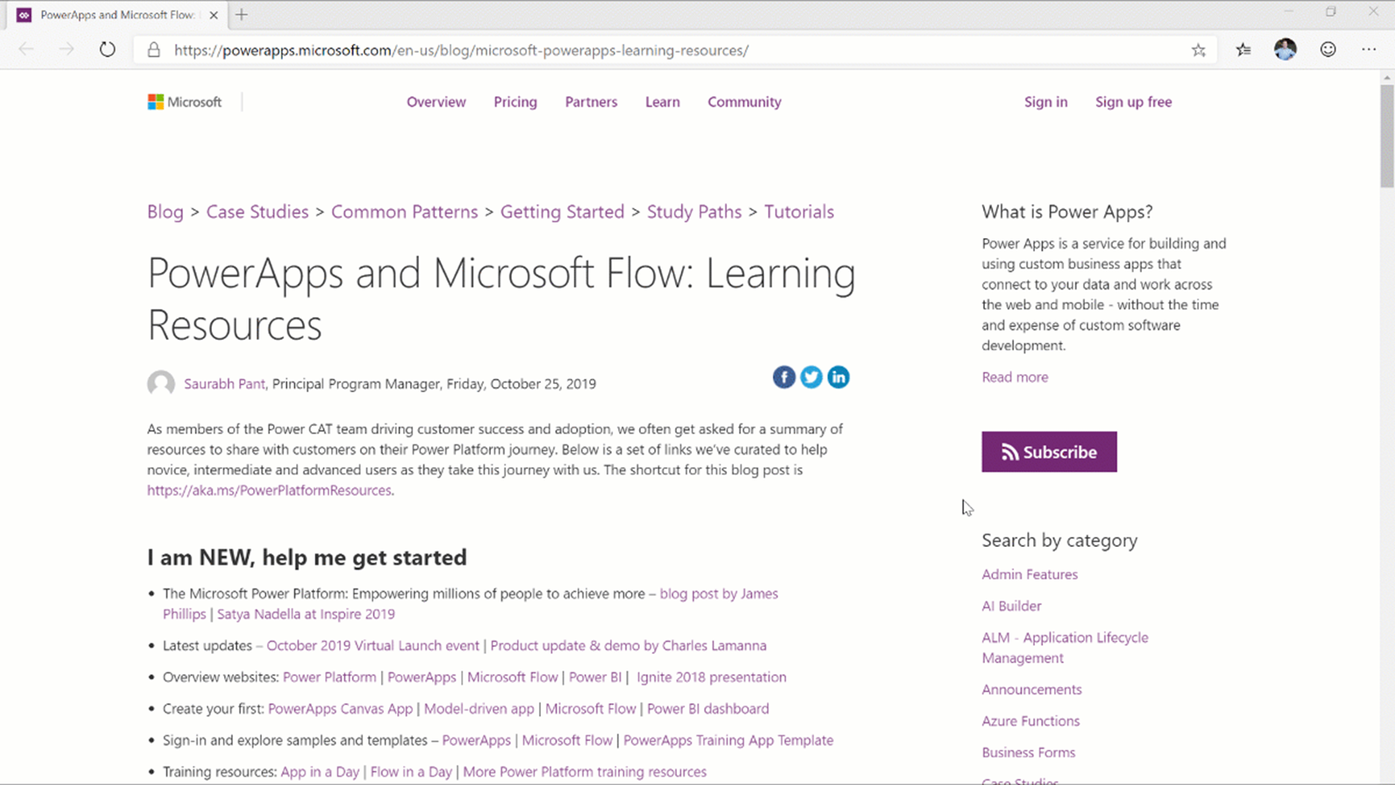

https://aka.ms/PowerPlatformResources

Slide 88
References
https://docs.microsoft.com/en-us/connectors/custom-connectors/define-blank
http://toddbaginski.com/blog/powerapps-coding-guidelines/
https://docs.microsoft.com/en-us/powerapps/maker/canvas-apps/working-with-variables
https://docs.microsoft.com/en-us/powerapps/maker/canvas-apps/formula-reference
https://docs.microsoft.com/en-us/powerapps/maker/canvas-apps/create-update-collection

